Slide 1
Michałowo

Slide 2
Michałowo
Michałowo is a city in Poland located in the Podlasie voivodship, in the Białystok poviat, in the Michałowo commune. About 3000 people live in Michałowo. The mayor of Michałowo is Włodzimierz Konończuk.

Slide 3
History of Michałowo
The name Michałowo derives from Seweryn Michałowski, the founder of the factory colony on the right bank of the Supraśl river, in 1832. In 1865 Michałowo became the property of von Minkwitz after Michałowski was sent to Siberia. During the Second World War, Michałowo was administrated by the famous mayor Paul Malzer, nicknamed "Bloody„. He was tried and sentenced to death after the war in Bialystok. In 1941, the Germans created a ghetto for Jews in Michałowo. Michałowo became city in 2009.

Slide 4
Interesting places in Michałowo

Slide 5
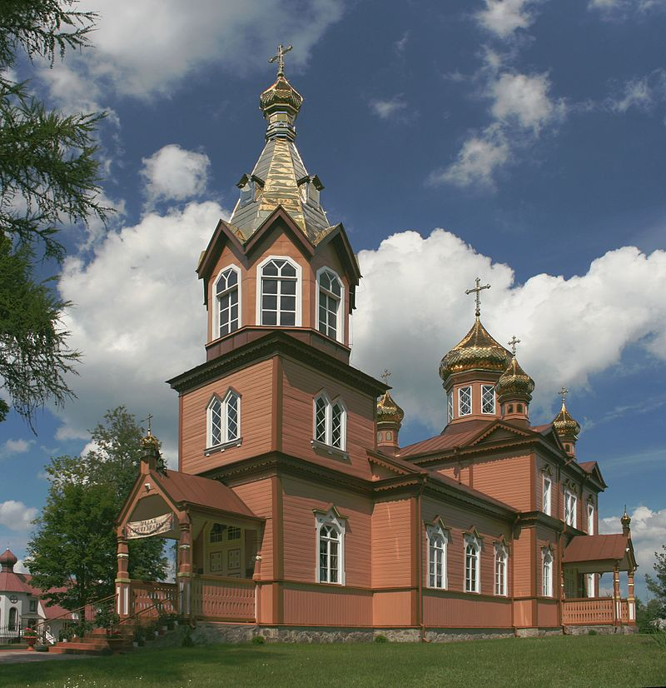
Orthodox church of St. Nicholas
Orthodox church of st.Nicholas -The buildnig is located at Młynowa street. It is a wooden temple on a stone foundation, built in 1907-1908, consecrated in September 1908 by the Archbishop of Grodno and Brzesko Michał. It has three galleries (which give the building the shape of a cross). There are 5 domes above the nave - one large and four smaller ones. In front of the tower-belfry with a height of 31 m, topped with a pyramidal cupola with a dome.

Slide 6
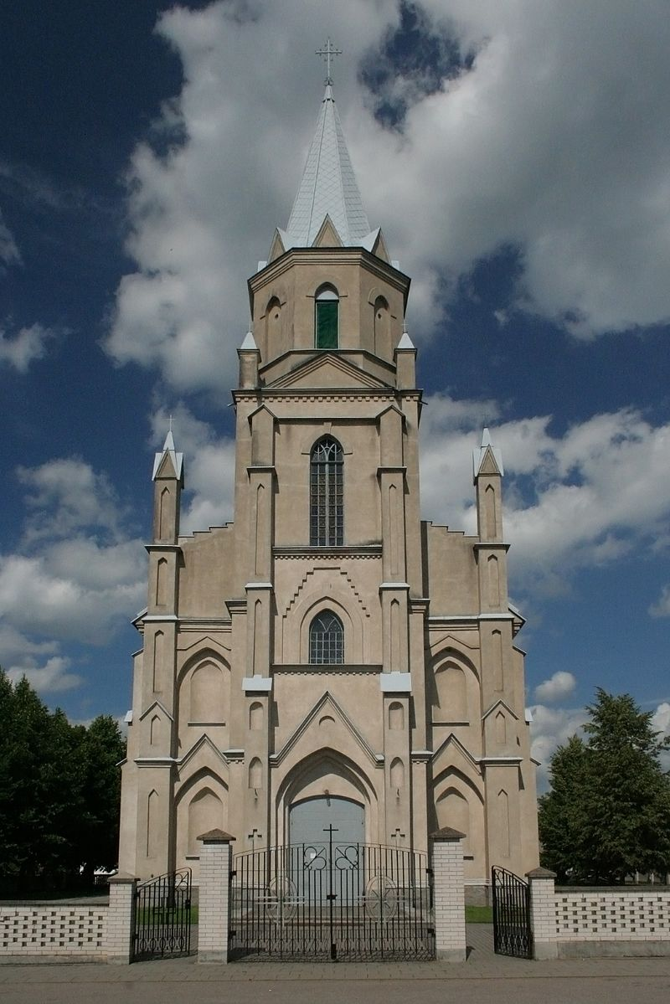
Church of Divine Providence
Church of Divine Providence in Michałowo is Roman Catholic parish church in the city of Michałowo, in the Podlasie voivodship. It belongs to Białystok - Dojlidy deanery of the Białystok Archdiocese.

Slide 7
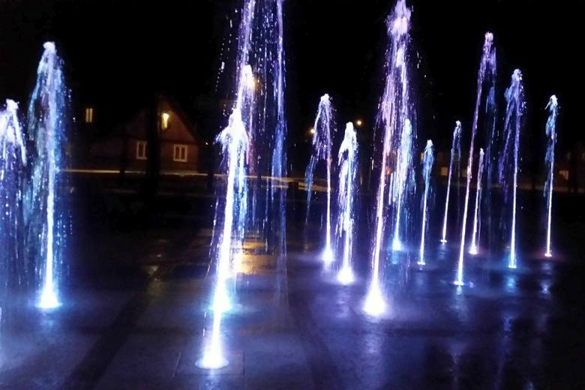
Park

Slide 8
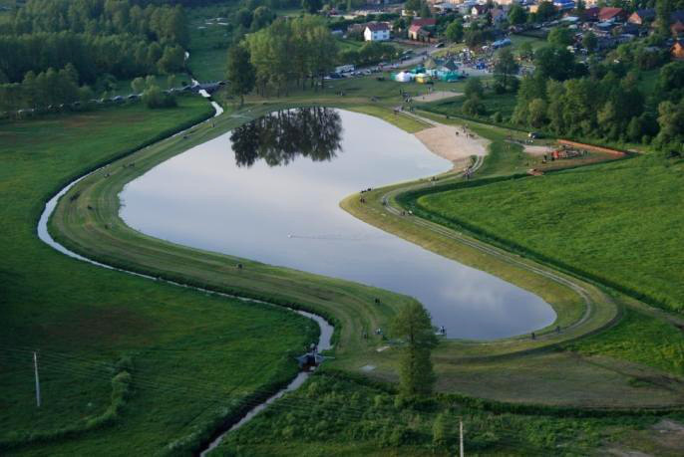
Lake

Slide 9
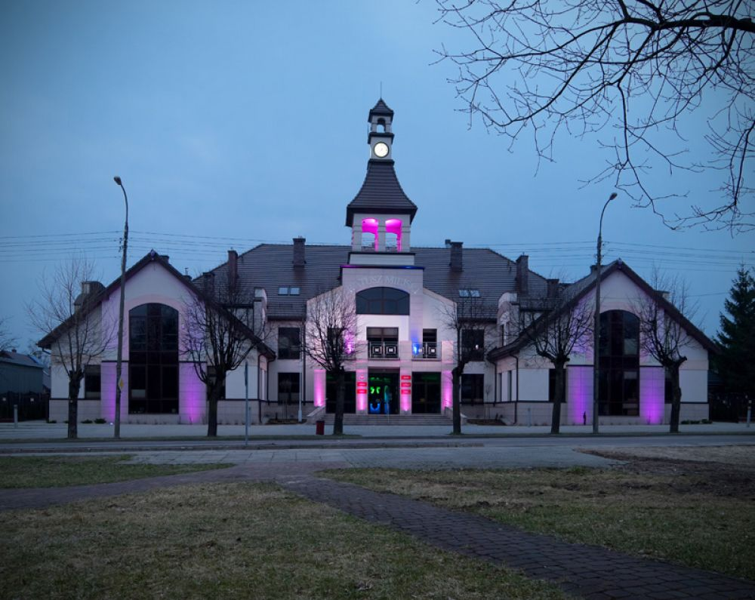
Town hall

Slide 10
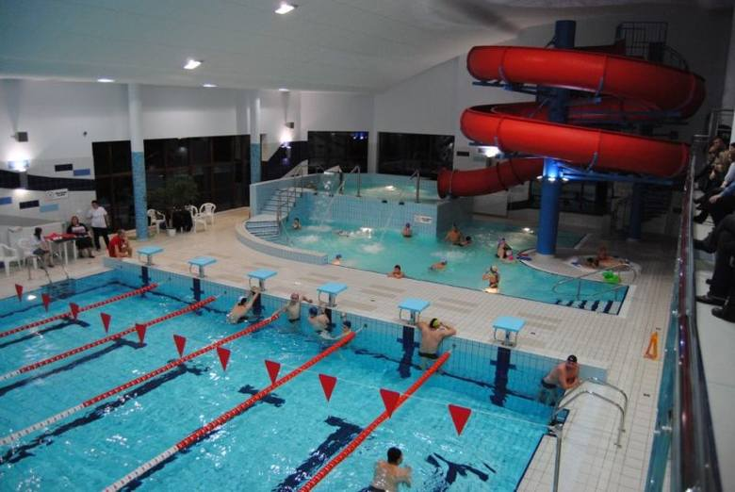
Swimming Pool

Slide 11
Thanks for watching ! Materials taken from Wikipedia, private resources
Daniel Cylwik, Ela Kościukiewicz III a

